Slide 1
NLTK
Natural Language ToolKit
(www.nltk.org)

Slide 2
What is nltk?
A tool which allows you to do NLP stuff such as Finding similar words in context, POS tagging etc.
We’ll be using nltk to write custom CFGs for the set of given sentences and produce parse trees for those sentences to check the accuracy of the grammar.

Slide 3
Download and Install (On your local machine)
http://www.nltk.org/download
.msi installation for windows
TarBall for Linux
.dmg for Mac

Slide 4
NLTK is installed on the cs4705 account
To use this,
add this line in the $HOME/.profile file in your CS account –
export PYTHONPATH=/home/cs4705/nltk-2.0b5
Then, either restart the shell or do
knl2102@helsinki /home/cs4705 $ . $HOME/.profile

Slide 5
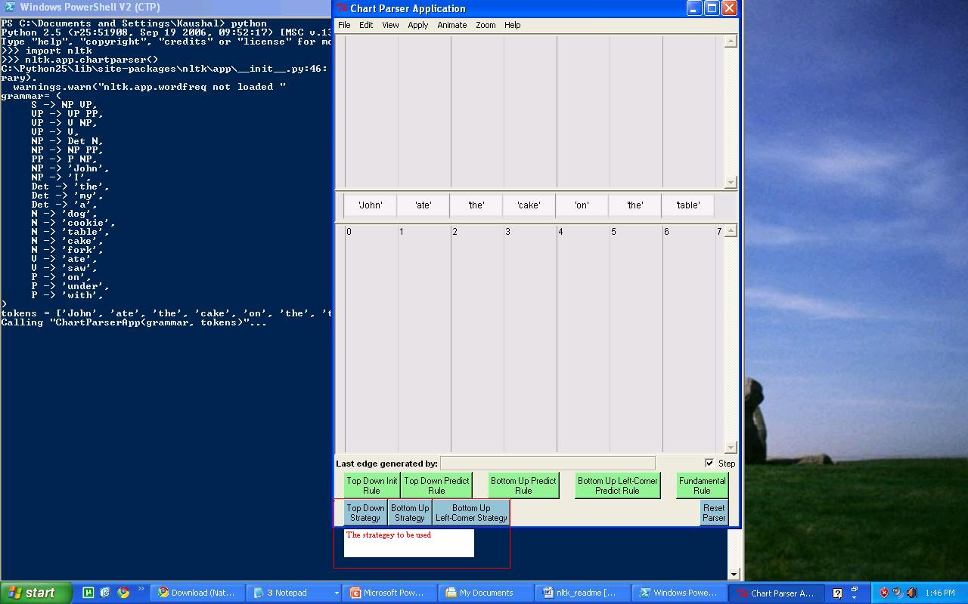
Bringing up the GUI for Chart Parser
nltk.app.chartparser()

Slide 6
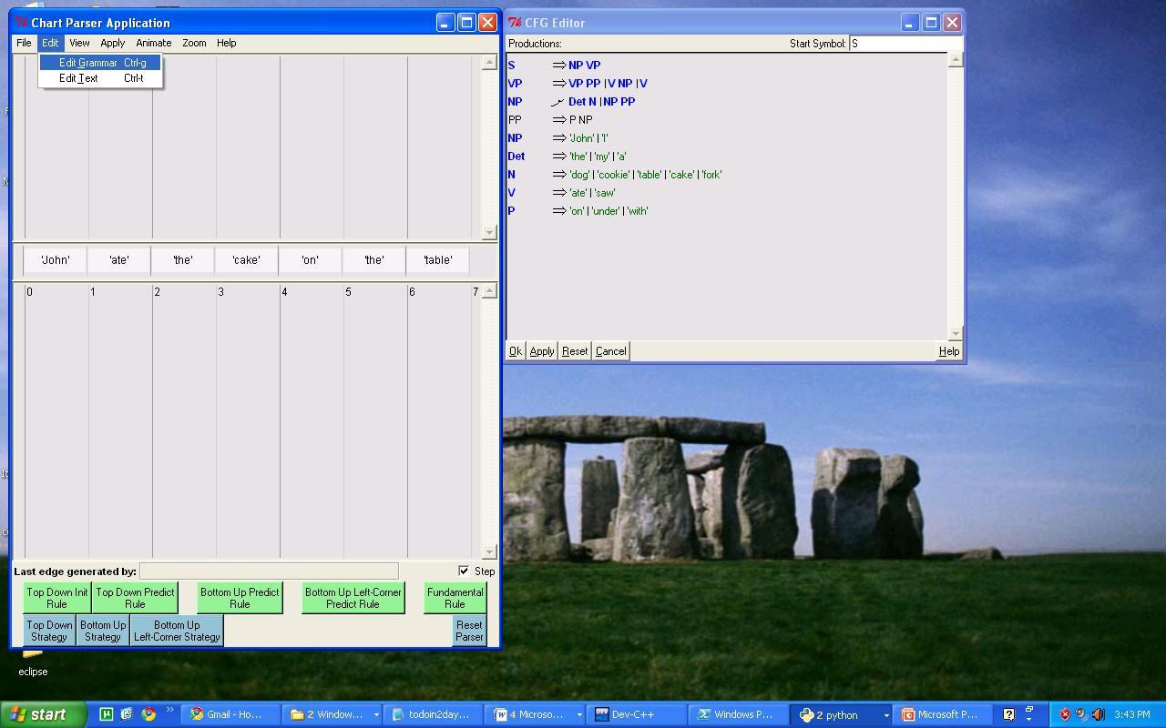
Loading the grammar

Slide 7
Stepping through the parse
To view the parse step by step, check the “Step” checkbox in the lower right corner.
To view the final parse without stepping through, uncheck “Step”

